Slide 1

Generation of Synthetic satellite images using GANs
Team T69 (Members - Vishisht Sharma, Shivan Bhatt, Sarthak Mishra)

Slide 2
Contents
Motivation
Research Gap
Objective
Methodology
Results and Discussions
Conclusion
Acknowledgements

Slide 3
1.
Motivation
The Why

Slide 4
Motivation
The rapid development of remote sensing technology supported by a significant improvement in access to remote sensing imagery led to an increased interest in the potential use of the collected material among academia, government, and private sector representatives in areas such as urban planning, agriculture, transport, etc.
The conventional data collection procedures are often extremely hectic and not scalable in case of multispectral images and the usual data augmentation techniques like noise injection and geometric transformations don’t capture the diversity and heterogeneity of the landscapes. Plus its expensive to get high resolution images.

Slide 5
2. Research
Gap
Hopefully, we have bridged it

Slide 6
Research Gap
Previous focus has been primarily on generating 8-bit grayscale or RGB images.
In terms of augmentation, only usual techniques like rotation, distortion etc have been used.
Scaling of models to higher dimension which feed upon higher resolution images and produce top quality data are required

Slide 7
3. Objective
What we aspire to do

Slide 8
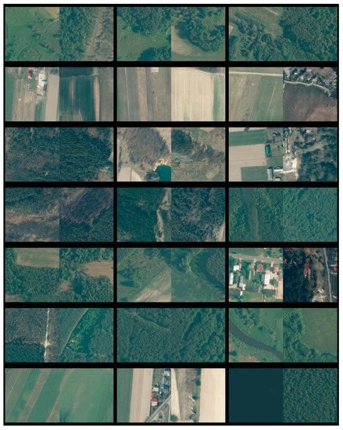
Real image, synthetic image
Generate indistinguishable multi-band satellite images.
Attempt to display the validity of the procedure and as a proof of concept

Slide 9
4. Methodology
Our complete pipeline of tasks what we did to finish this project

Slide 10
One step at a time
Data Preparation
Model Building
Synthesis

Slide 11
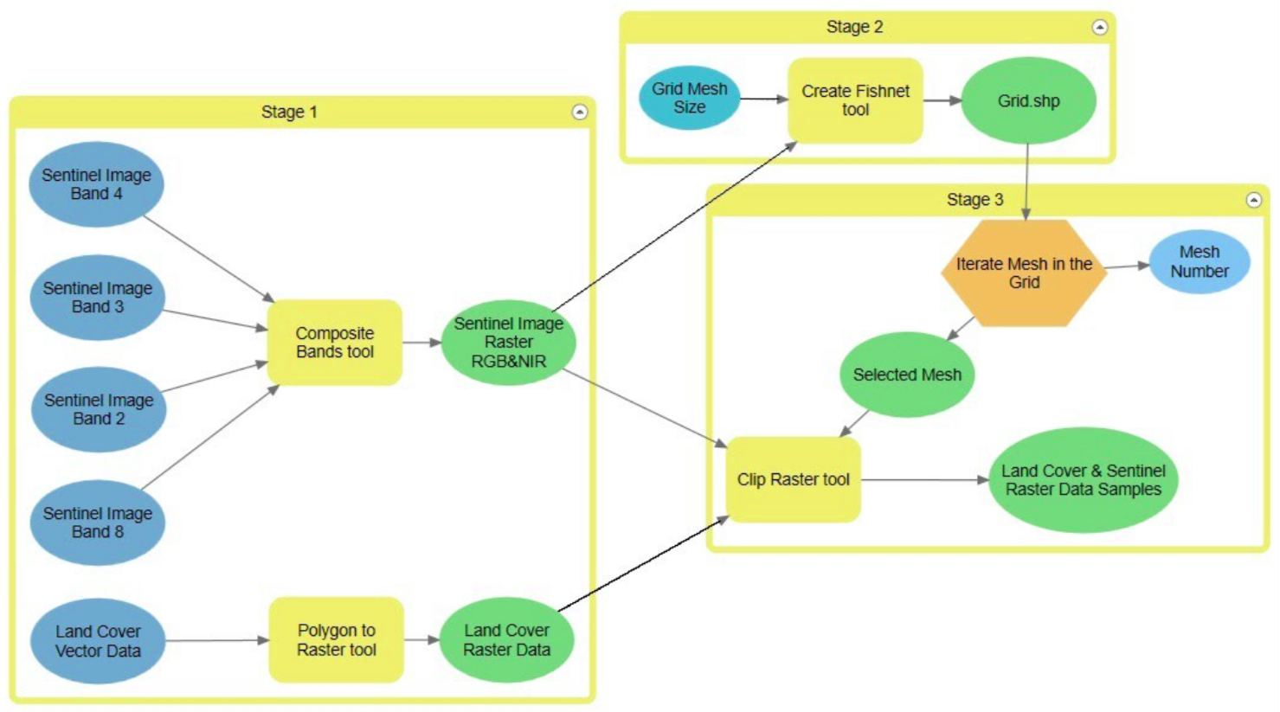
Data Preparation
The data was prepared from images taken by the Sentinel 2 database provided by Copernicus Open Access Hub.
Images with little or no cloud cover were used for the project.

Slide 12
Stage 1
ArcGIS Pro software was used to prepare the data.
In the first stage, using the Composite Bands tool Sentinel data bands: 4 (red), 3 (green), 2 (blue) and 8 (nir) all with a resolution of 10 meters, were combined and a four-band raster was created.
Then the land cover vector data with the polygon topology were changed to raster data using the Polygon to Raster tool.

Slide 13
Stage 2
In the second stage, it was crucial to match the coordinate system and extent with the data acquired from Sentinel.
The extent value read from Sentinel data allowed us to process only a portion of a larger land cover dataset.
It was also important to determine Snap Raster environment setting.

Slide 14
Stage 3
In the third stage, by iterating through the grid items and using the Clip Raster tool, the Sentinel Image and Land cover raster data were cut into parts, overlapping with the consecutive mesh.
The sample set was created. The same procedure was used for land cover data at both scales and to create samples of different sizes by changing the mesh parameter.

Slide 15
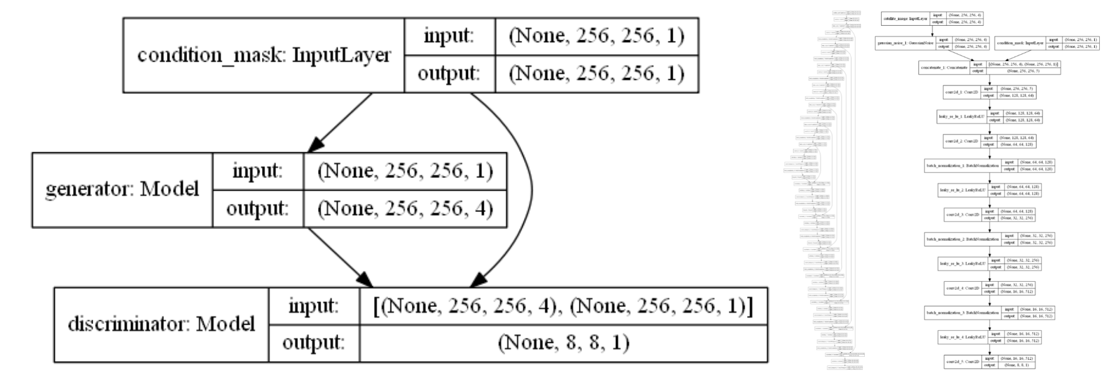
Model
Network model. Pix2Pix GAN, Generator: U-Net, Discriminator: PatchGAN

Slide 16
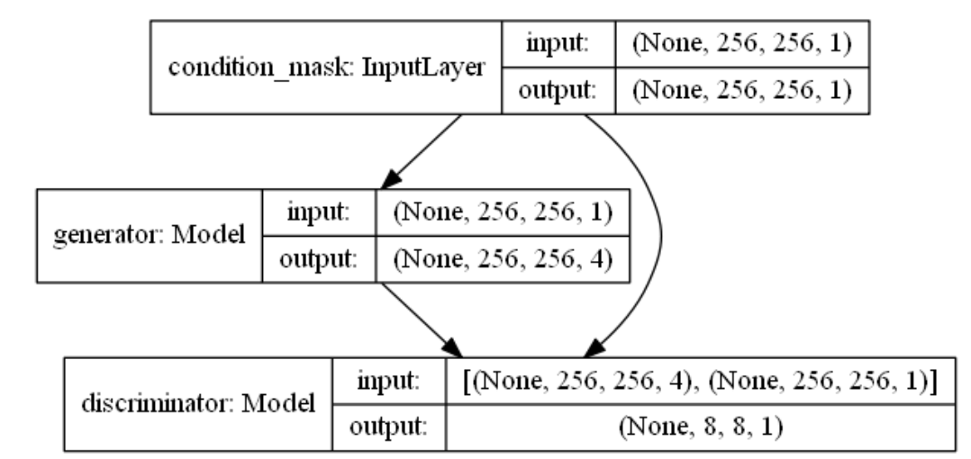
GAN Model
The overview:
The input layer is the conditional mask layer that feeds single band tiff to the network.
The generator model uses the input to create a 4-channel output image.
Then, the discriminator model judges the generated image and casts a penalty in terms of loss to improve the generator.

Slide 17
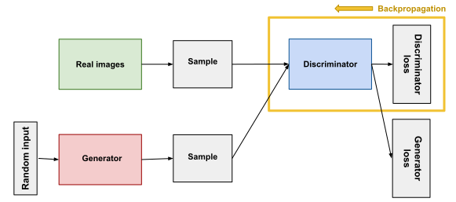
Discriminator Model

Slide 18
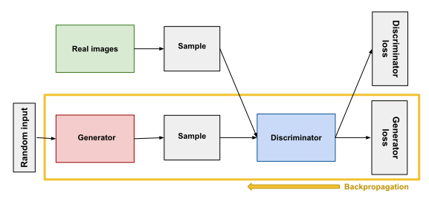
Generator Model

Slide 19
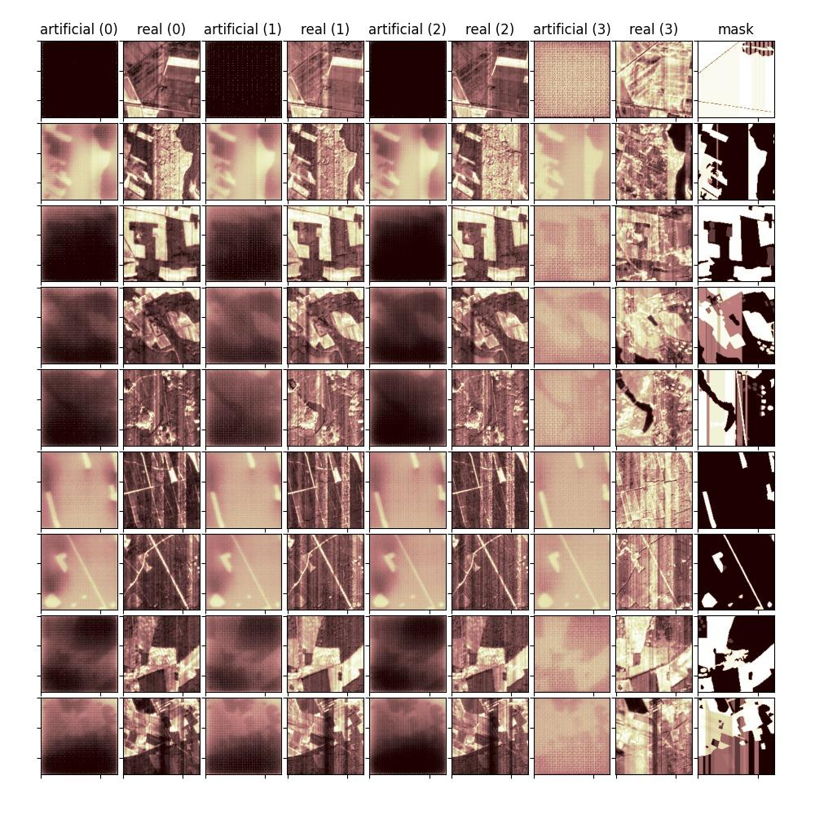
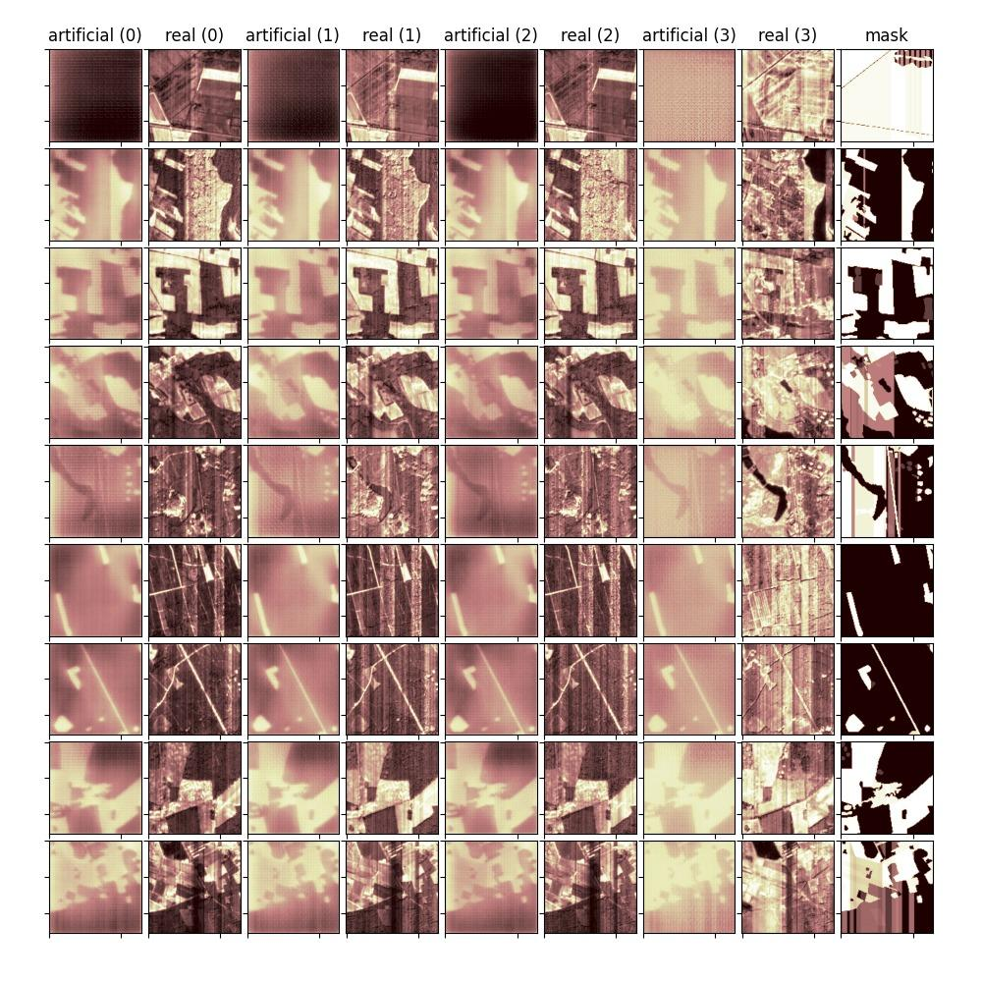
Synthesis

Slide 20
5. Results
Results and Discussions

Slide 21
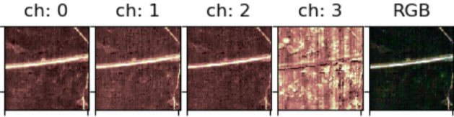
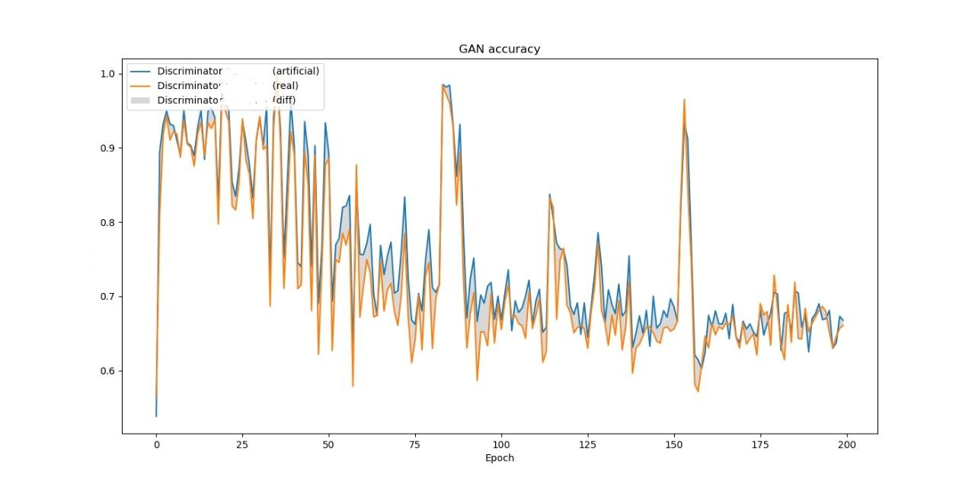
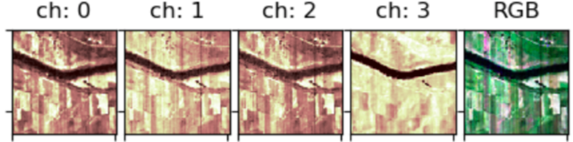
Results
Trained for 200 epochs on a dataset of ~ 2000 samples.
Artificially generated images
Loss

Slide 22
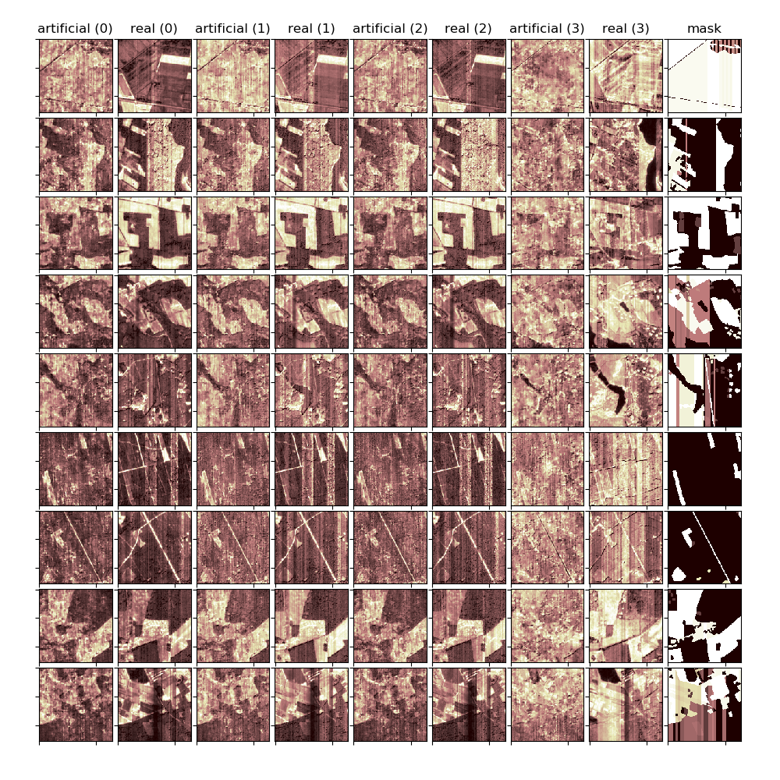
Discussion
Using higher resolution images with RGB bands visually striking artificial images can be generated by the model
GAN performance after 200 epochs

Slide 23
6. Conclusion
Final comments

Slide 24
Conclusion and Future works
Generative adversarial networks are a powerful tool in the machine learning toolbox.
In case of satellite image processing they provide not only a good mechanism of creating artificial data samples but also enhancing or even fixing images.
We should increase image resolution.
Exploring other GAN architectures.

Slide 25
References
Abady, Lydia & Barni, Mauro & Garzelli, Andrea & Tondi, Benedetta. (2020). GAN generation of synthetic multispectral satellite images. 19. 10.1117/12.2575765.
Goodfellow, I, Abadie, J. P., Mirza, M, Xu, B, Warde-Farley, D, Ozair, S, Courville, A, Bengio, Y., "Generative Adversarial Networks", NIPS, 2014.
https://machinelearningmastery.com/how-to-develop-a-pix2pix-gan-for-image-to-image-translation/
Arjovsky, M., Chintala, S., Bottou, L., "Wasserstein generative adversarial networks", International conference on Machine Learning (2017), pp. 214-223
Salimans, T., Goodfellow, I., Zaremba, W., Cheung, V., Radford, A., Chen, X., "Improved techniques for training GANs", Advances in Neural Information Processing Systems (2016), pp. 2234-2242

